Slide 1
MTM 2021
Misconduct control - WARNINGS AND SANCTIONS
Notes:
This module gives an explanation about misconduct sanctions and their application. It contains some video illustration about the practice.
At the end of the module, there are some questions for you to test yourself about your knowledge and understanding of how to apply the rule.

Slide 2
JUDGEMENT OF MISCONDUCT
Requirements:
  - skill to build own authority
  - understanding of match process
  - psychological skills
  - experience
Notes:
There is an endless variety of unwanted behaviour by participants in a volleyball match. Through the net comments between players, overexcited joy after a point won, significant looks straight into an opponent’s eyes, protests against referees’ decisions. Gestures, words, aggression...You will find all of these to some degree in any match at any level.
The ability to control and prevent players and coaches from increasing their negative emotions or trying to influence opponents or referees requires skill to build one’s own authority, understanding of the match process, psychological skills , as well as experience. In some cases too strong an involvement by a referee in the beginning of the match may cause the result of the match to be overshadowed by unsportsmanlike behaviour or clouded by following sanctions at the very end. And the opposite: too weak refereeing may allow a volleyball match to turn into a show of disrespect and aggression.

Slide 3
MINOR MISCONDUCT
  1st referee’s duty: to prevent the teams from approaching the sanctioning level
  Minor misconduct offences are not subject to sanctions.
  Warnings should be used wisely to control the behaviour.
  Cooperation among refereeing corps is essential – involvement of the 2nd referee.
Notes:
It is the 1st referee’s duty to prevent the teams from approaching the sanctioning level. Let’s underline: it is the referee’s obligation to understand what the teams try to achieve by their misconduct and to set a border for what is allowed and what is not. A flexible tool has been inserted into the rules to help the referee with this task: warnings for minor misconduct.
This kind of offence is not subject to sanctions. Therefore immediate and consistent use of warnings will allow the referee to keep the control of the match and the behaviour of its participants.

Slide 4
MINOR MISCONDUCT
The behavior of the participants should be respectful and courteous to everybody.
If the coach’s attitude exceeds the disciplinary limitations, the 1st referee has to apply the appropriate sanctions without any hesitation.
If the coach (or any other team member) appeals loudly or in an aggressive or derogatory manner, or insult (by doing so even just to attract attention of the crowd), the 1st referee must make a strict application of the sanctions scale.
The show must be for the play on the court and not for peripheral issues which detract from the main purpose of entertaining the crowd with spectacular play. The coach is not the show!

Slide 5
PREVENTING STEPS
  Two stages:
  Stage 1: a verbal warning through the game captain about the general behaviour of the team.
  It is considered as a team warning.
  Stage 2: use of yellow card shown to the team member concerned. Still team warning!
  The 1st referee has flexibility here.
  The 1st referee is not a policeman.
Notes:
The prevention can be done in two stages. In stage one a verbal warning via the team captain is issued. It concerns the general behaviour of the team. In stage two a yellow card is shown. However, although it is shown to a specific team member, it is still a team warning.
It must be underlined that a referee has flexibility to issue stage 1 or stage 2 warnings according to his/ her judgement of participants’ misconduct.

Slide 6

PREVENTING STEPS video
Notes:
In the video you can see one possible usage of a warning. When both teams, deep into the high stakes match, start to discuss through the net, the referee calls both captains to the stand and warns both teams at the same time in order to lower the tension on court.

Slide 7
YELLOW CARD
  It is not a sanction but the effect of the warning lasts for the remainder of the match.
It tells everyone clearly that the team member (and the whole team) has reached the sanctioning level.
  It is recorded in the score sheet against the individual team member.
Notes:
Showing a yellow card closes the warning stage for the team in the match. It is the symbol that the team has reached the sanctioning level and the next misconduct by any team member should be sanctioned by a penalty. It is recorded in the score sheet against the individual team member but it has consequences for the whole team.

Slide 8
WARNINGS VS. SANCTIONS
  Differences:
    - Warnings are effective for the whole team.
    - Sanctions are for the person and are used progressively.
It is possible to go back to a yellow card after a player was sanctioned for really bad behaviour earlier in the match – e. g. the player was given a penalty or expelled.
But now the TEAM will have reached the sanctioning level. Any further misconduct should be automatically sanctioned.
Note: only one yellow card for a minor misconduct may be shown to a team in the match
Notes:
A crucial difference between warnings and sanctions is that the first are effectively for the whole team, while the latter are for the individual person and should be used cumulatively. In exceptional cases, it may happen, that a team member guilty of really bad behaviour is already sanctioned individually; meanwhile, the whole team has not reached the sanctioning level yet. It means that any player, other than the one sanctioned before, may be still be warned with a yellow card. At this point the team would have reached the sanctioning level – any further misconduct would generate a sanction for whoever committed the misconduct. The sanctioned player, if personally guilty of further misconduct would of course be given an increased sanction.
Pay attention, that a team may be warned for minor misconduct by a yellow card only once per match!

Slide 9
SUMMARY OF MISCONDUCT AND CARDS USED (RULE 21.6)
Warning: Stage 1: verbal warning
Stage 2: Yellow card
Sanctions:
Penalty: Red card
Expulsion: Red + Yellow cards jointly
Disqualification: Red + Yellow card separately
Notes:
The sanction table shown summarizes two kinds of warnings and three kinds of sanctions foreseen in the Rules. Except for the stage one warning, they require the usage of cards and are recorded in the score sheet.

Slide 10
SANCTIONS AND THEIR CONSEQUENCES
Penalty – rude conduct – point and service to the opponent
Progressive use of sanctions
Expulsion – offensive conduct – substitution – dressing room until end of the set.
Disqualification – aggression – substitution – dressing room until end of the match

Slide 11
SUBSTITUTION OF EXPELLED/DISQUALIFIED PLAYER
Expelled/disqualified player on court – to be substituted immediately (not replaced by Libero player)
Regular/legal substitution
Exceptional substitution – an option for the team, not an obligation!
Incomplete team for set/match

Slide 12
SHOWING A CARD
  The team member concerned should be clearly indicated for the team, 2nd referee and all the public.
  Player on the court: instructed to approach referee’s stand.
  Team member not on the court: informed through the game captain. Must acknowlegde the sanction by raising his/her hand.
  Active use of communication system is recommended.
Notes:
The process of showing a card has its own significance. The team member concerned should be clearly indicated for the team, 2nd referee, the scorer, the TV people and all the spectators. The team member should also understand for what behaviour the card is shown. If it is a player on court to whom the referee shows the card, the identification is easy – the referee calls the player to his post. But if it is another member of the team then the game captain is called to the post, informed about the warning or the sanction and asked to transfer the information to the team member concerned. The game captain must inform the concerned team member who must stand up and acknowledge the sanction by raising his/her hand. While the team member’s hand is raised, the 1st referee clearly displays the card/s so that the sanction is understood by the teams, 2nd referee, scorer and public.

Slide 13
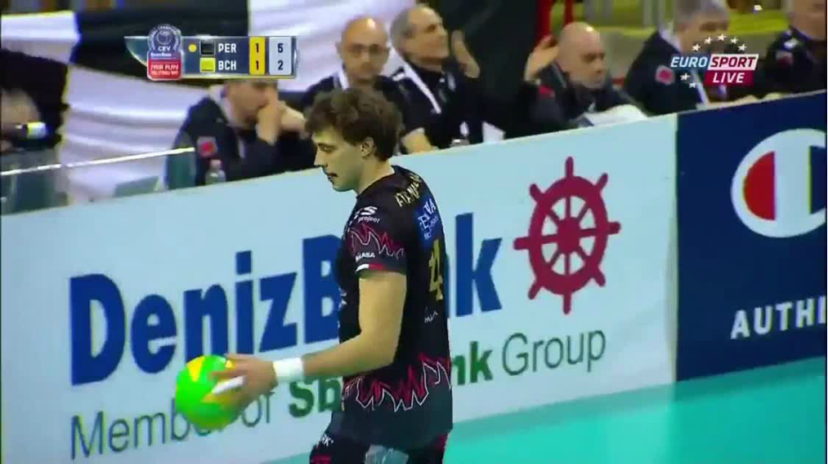
SHOWING A CARD
Notes:
In the video a yellow card was shown to the coach. The game captain didn’t go to the coach and we can’t see him raising his hand. The referee showed the yellow card while the game captains stood by his chair, indicated the coach with a hand. However in the end it seems everybody understood who was warned with the yellow card – even the TV broadcaster directed the camera on the coach – but it would be more proper to follow the procedure described in the previous slide.

Slide 14
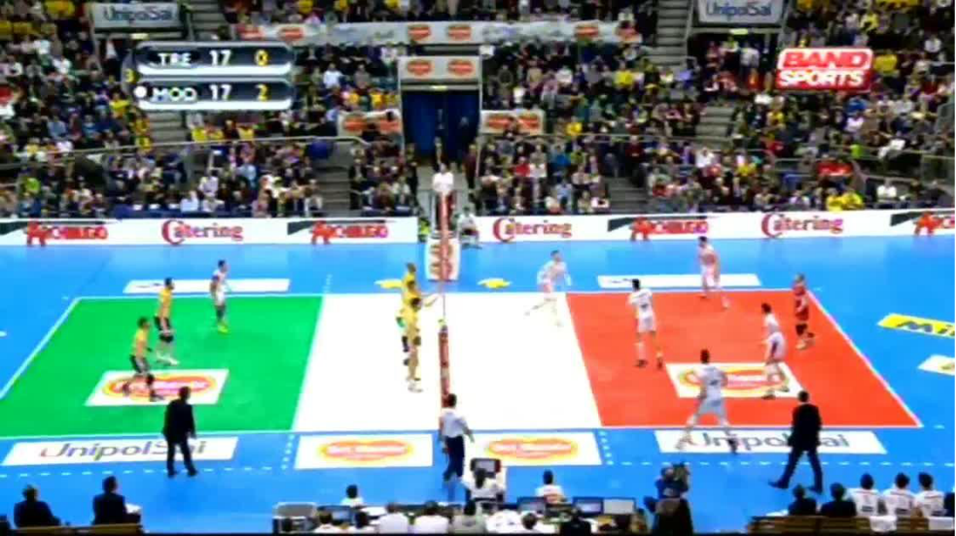
SHOWING A CARD
Notes:
In this video the yellow card is displayed too many times, without calling the warned player to the referee at first. As the players are grouped when the card is shown for the first time, it is nearly impossible to understand to whom it is presented. Sometimes it is not easy to follow the regulation, but the referee should make all efforts to make the situation obvious for everybody. Finally the process of issuing the yellow card was correct. The rude conduct by the player who applauded after he had been warned with yellow card required issuing a penalty. This was not, however, done completely according to the actual instructions.

Slide 15
SHOWING A CARD
What to tell:
  „I warn you / I warn (coach, player number x, etc.). Your team has reach the sanctioning level.”
  „I give you a penalty / I give a penalty to (coach, player number x, etc.)”
  „I expel/disqualify you / I expel/disqualify (coach, player number x, etc.)
Notes:
Informing about the warning or sanction, the referee should verbally give information about the kind of sanction being issued. In short - the sentences „I give you a penalty” or „I expel the coach” are clear enough .

Slide 16
SHOWING A CARD
Video for expulsion

Slide 17
SHOWING A CARD
Video Yellow card good collaboration

Slide 18
IMPLEMENTATION OF SANCTIONS BETWEEN SETS
Any misconduct occurring before or between sets – to be applied in the following set.
Penalty – the 1st referee should show the red card at the start of the next set.
Expulsion or disqualification – to prevent double sanction - the 1st referee should call the game captain immediately to inform the coach concerned about the type of sanction – the cards to be shown at the start of the next set.

Slide 19
IMPLEMENTATION OF SANCTIONS BETWEEN SETS
Video yellow card for coach before set

Slide 20
IMPLEMENTATION OF SANCTIONS TO BOTH TEAMS
In case of sanctioning both teams:
  heavier sanction to be issued first
  serving team to be sanctioned first
    exception – end of the set

Slide 21
PRACTICE QUESTIONS
true false
1. The 1st referee is obliged to follow the sequence of minor misconduct warning, to issue stage 1, then stage 2.
2. Yellow card shown to a player is considered as a team warning.
3. After a team member was sanctioned, the team may not be warned anymore, neither with stage 1 nor with stage 2 (even there was no warning before).
4. When the 1st referee issues a red card to a coach, he/she should show it twice: first during communication to the game captain, then when the coach raises his/her hand.
Notes:
Let us see some questions about the rule of misconduct. You should reply, if the sentence is true or false.
Question 1. The first referee is obliged to follow the sequence of minor misconduct warning, to issue stage 1, then stage 2
It is false, because a warning should be issued according to participants’ misconduct. The 1st referee has the right to start with yellow card
Question 2. Yellow card shown to a player is a special team warning
Yes, it is true. Although the yellow card is issued due to a personal behavior, it is valid for the whole team.
Question 3. After a team member was sanctioned , the team may not be warned anymore neither with stage 1 nor with stage 2 (even there was no warning before).
It is false. The sanctions for misconduct – penalty, expulsion, disqualification – are individiual ones. If there was not any warnings for the team, it means, the whole team did not reach the sanctioning level. Therefore they may be still warned.
Question 4. When the 1st referee issues a red card to a coach, he/she should show it twice: first during communication to the game captain, then when the coach raises his hand
It is false. The card for a team member is to be shown, only when the game captain informed him/her about the sanction and the hand is raised up

Slide 22
This course is now complete
Thank you for choosing the
MEVZA Teaching Material 2021

